Slide 1
COMMON DISEASES

Slide 2
INTRODUCTION
A disease is a particular abnormal condition, a disorder of a structure or function, that affects part or all of an organism.
Common diseases are those diseases that affects most population
Diseases are sub divided according to the systems
Nervous system
Cardiovascular system
Respiratory system
Gastro intestinal system
Genital urinary system
muscular skeletal system

Slide 3
Nervous system
definition
Nervous system is The system in the body that controls internal functions of the body and receives, interprets, and responds to stimuli.
Nervous system comprises of brain ,spinal cord and nerves

Slide 4
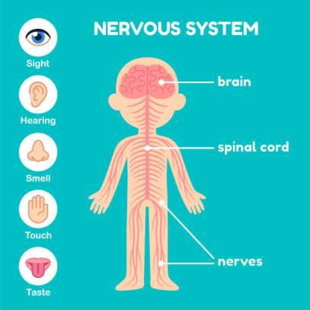

Slide 5
COMMON DISEASES OF THE NERVEOUS SYSTEM
Headache
Epilepsy and seizures
Stroke
Alzheimer's disease and dementia
trauma

Slide 6
headache
If headache comes once and disappears is not a problem but when its more frequent and un bearable then it becomes a disease
Causes of frequent headaches
inflammation or other problems with the blood vessels in and around the brain, including
stroke.
Infections, such as meningitis.
Intracranial pressure that's either too high or too low.
Brain tumor.
Traumatic brain injury.

Slide 7
EPILEPSY AND SEIZURES
DEFINATION
A seizure is a sudden, uncontrolled electrical disturbance in the brain. It can cause changes in your behavior, movements or feelings, and in levels of consciousness.
Epilepsy is Having two or more seizures at least 24 hours apart that aren't brought on by an identifiable cause .

Slide 8
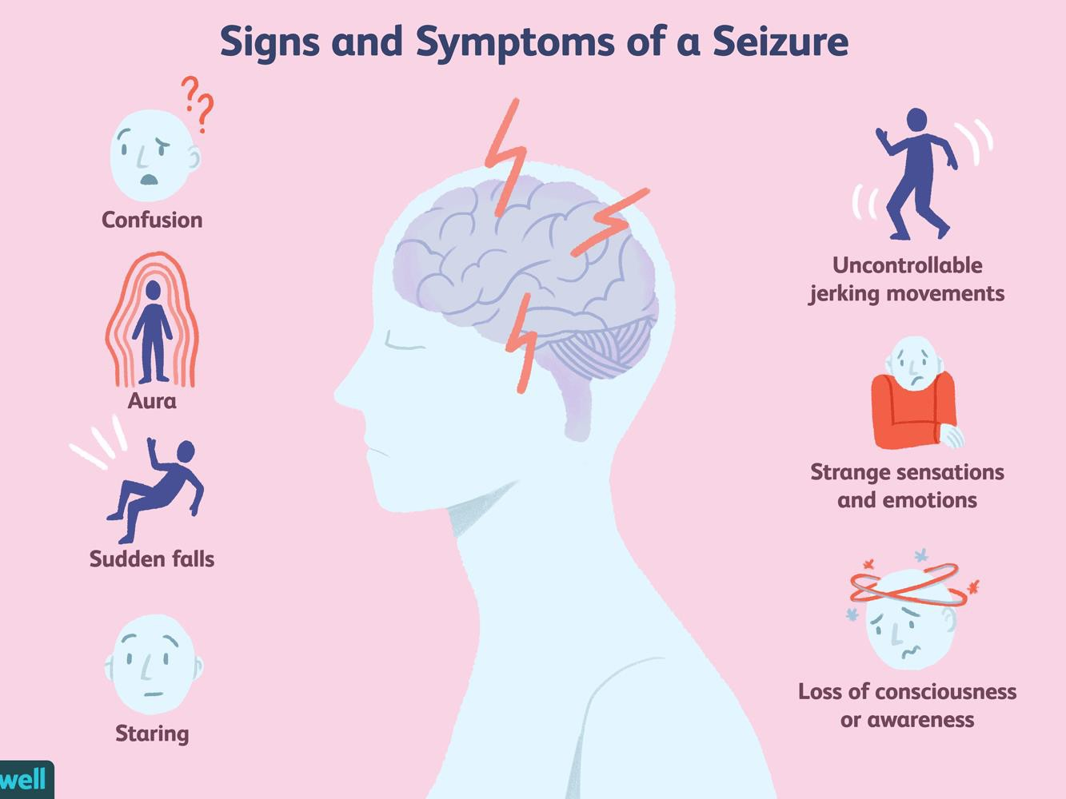
SIGNS AND SYMPTOMS

Slide 9
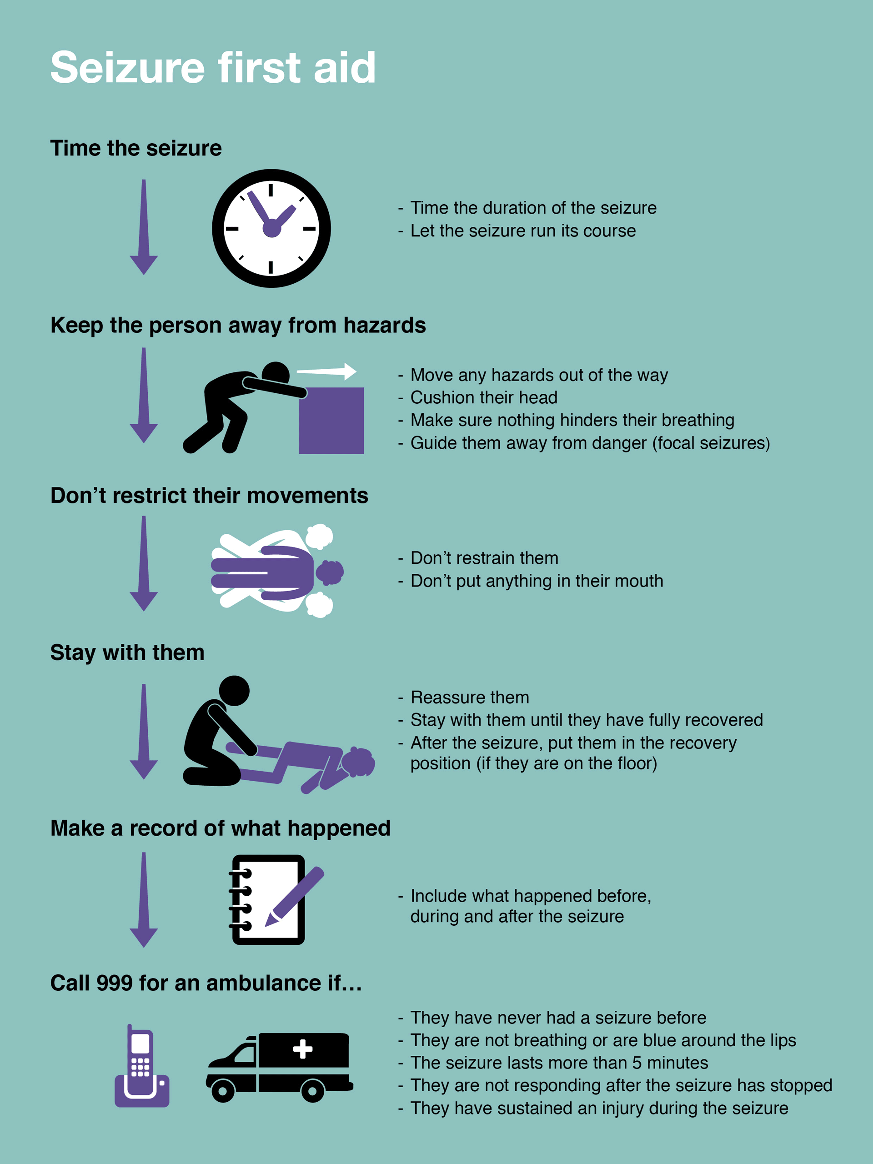
FIRST AID OF A SEIZURE

Slide 10
STROKE
Cerebrovascular accident (CVA) is the medical term for a stroke. A stroke is when blood flow to a part of your brain is stopped either by a blockage or the rupture of a blood vessel.
SIGNS AND SYMPTOMS
difficulty walking
dizziness
loss of balance and coordination
difficulty speaking or understanding others who are speaking
numbness or paralysis in the face, leg, or arm, most likely on just one side of the body
blurred or darkened vision
a sudden headache, especially when accompanied by nausea, vomiting, or dizziness

Slide 11
Alzheimer's disease and dementia
Alzheimer’s disease is an irreversible, progressive brain disorder that slowly destroys memory and thinking skills and, eventually, the ability to carry out the simplest tasks. It is the most common cause of dementia in older adults.
Dementia is not a specific disease but is rather a general term for the impaired ability to remember, think, or make decisions that interferes with doing everyday activities. more common as people grow older, it is not a normal part of aging.

Slide 12
TASK
Write notes on :
Meningitis
Brain tumor
Neurological assessment

Slide 13
CARDIOVASCULAR SYSTEM
The cardiovascular system consists of the heart, blood vessels, and blood
FUNCTION OF THE HEART is to pump blood and distributing oxygen and nutrients throughout the body .
Task
Draw and label the human heart showing the blood flow

Slide 14
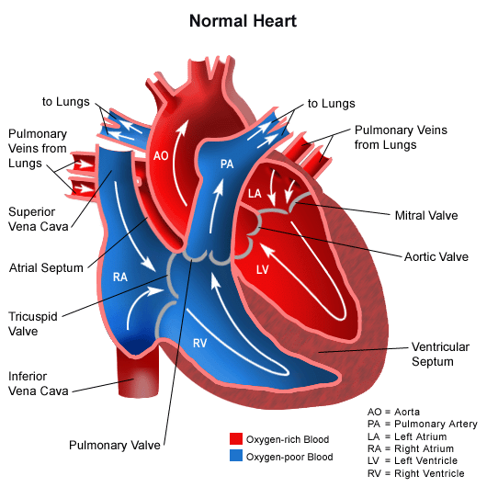
ANATOMY OF THE HEART SHOWING BLOOD FLOW

Slide 15
DISEASES IN THE CARDIOVASCULAR
High blood pressure (hyperten_{S}si_{Y}on_{S}) i_{T}s a_{E}co_{M}mmon condition which Is caused by
long-term force of the blood against artery walls which may eventually cause health problems, such as heart disease and stroke .
coronary heart disease – a disease of the blood vessels supplying the heart muscle
cerebrovascular disease – a disease of the blood vessels supplying the brain
peripheral arterial disease – a disease of blood vessels supplying the arms and legs
congenital heart disease – birth defects that affect the normal development and
functioning of the heart caused by malformations of the heart structure from birth
deep vein thrombosis and pulmonary embolism – blood clots in the leg veins, which can dislodge and move to the heart and lungs.

Slide 16
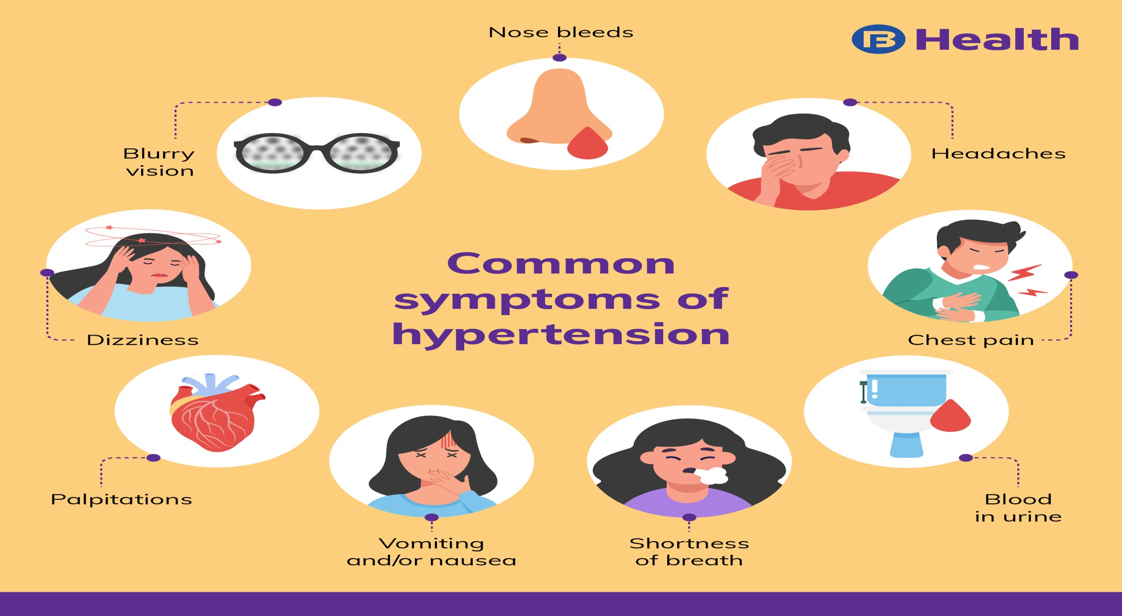
SIGNS AND SYMPTOMS OF HYPERTENTION

Slide 17
HYPOTENSION
Hypotension is when blood pressure is below 90/60 mmhg
CAUSES
Emotional stress, fear, insecurity or pain (the most common causes of fainting)
Dehydration, which reduces blood volume
The body’s reaction to heat, which is to shunt blood into the vessels of the skin, leading to dehydration
Blood donation
Internal bleeding, such as a perforated stomach ulcer
Blood loss from trauma, such as a road accident or deep cut
Pregnancy
Medications for high blood pressure

Slide 18
CONTINUED
Diuretics, which produce fluid loss
Medications for depression
Medications for certain heart conditions
Allergic reaction to certain drugs or chemicals
Some forms of infection, such as toxic shock syndrome
Heart disease, which can hamper the pumping action of the heart muscle
Some nervous system disorders, such as Parkinson’s disease

Slide 19
MANAGEMENT OF HYPOTENSION
Rehydration –give patient adequate amount of water
Blood pressure close monitoring
Arresting bleeding
Blood transfusion
Eating iron based foods during pregnancy
Proper treatment of infections
Blood pressure check before administering hypertension medication
(antihypertensive)

Slide 20
Cardiac arrest
cardiac arrest occurs when the heart ceases to produce an effective pulse and circulate blood. It may be caused by a
cardiac electrical event (i.e., dysrhythmia) such as ventricular fibrillation, progressive profound bradycardia, or when
there is no heart rhythm at all (a systole). Cardiac arrest may follow respiratory arrest; it may also occur when electrical
activity is present but there is ineffective cardiac contraction or circulating volume, which is called pulseless electrical activity (PEA). PEA can be caused by hypovolemia (eg,
with excessive bleeding), hypoxia, hypothermia, hyperkalemia, massive pulmonary embolism, myocardial infarction, and medication overdose (e.g., beta-blockers, calcium
channel blockers).

Slide 21
Clinical manifestations
In cardiac arrest, consciousness, pulse, and blood pressure are lost immediately. Ineffective respiratory gasping may occur. The pupils of the eyes begin dilating within 45 seconds. Seizures may or may not occur.
The risk of irreversible brain damage and death increases
with every minute from the time that circulation ceases. The interval varies with the age and underlying condition of the patient. During this period, the diagnosis of cardiac arrest must be made and measures must be taken immediately to restore circulation.

Slide 22
management
Initiate immediate cardiopulmonary resuscitation (CPR).
Institute follow-up monitoring once patient is resuscitated.

Slide 23
TASK
In groups discuss and Write notes on Myocardia infarction
Coronary artery disease Ischemic heart disease Cardiac edema
Angina pectoris
1.
2.
3.
4.
5.
INDICATE
Definition
clinical presentation /signs and symptoms
Prevention
Management

Slide 24
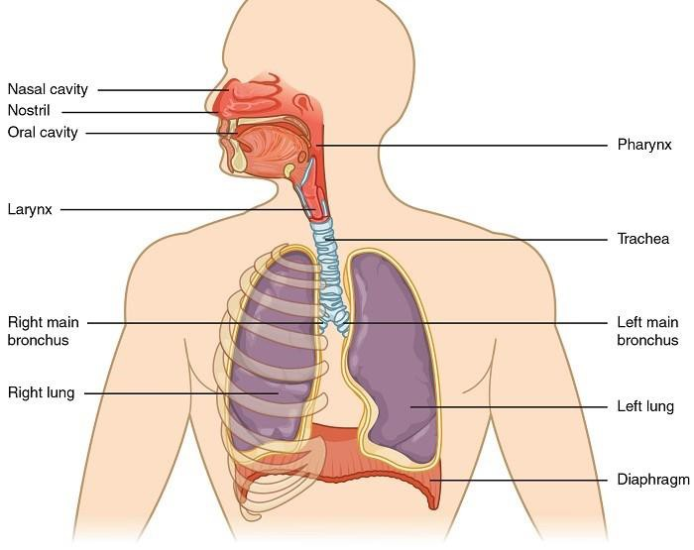
RESPIRATORY DYSTEM
The respiratory system is the network of organs and tissues that help you breathe. It includes airways and lungs

Slide 25
Nasal Cavity
The nasal cavity
is a large, air-filled space in the skull
above and behind the nose in the middle of the face. It is a continuation of the two nostrils. As inhaled air flows through the nasal cavity
, it is warmed and humidified. Hairs in the nose help trap larger foreign particles in the air before they go deeper into the respiratory tract
. In addition to its respiratory functions, the nasal cavity
also contains chemoreceptors that are needed for the sense of smell and that contribute importantly to the sense of taste. Pharynx
.

Slide 26
pharynx
is a tube-like structure that connects the nasal cavity
and the back of the mouth to other structures lower in the throat, including the larynx
. The pharynx
has dual functions: both air and food
(or other swallowed substances) pass through it, so it is part of both the respiratory and digestive systems. Air passes from
the nasal cavity
through the pharynx
to the larynx
(as well as in the opposite direction). Food
passes from the mouth through the pharynx
to the esophagus

Slide 27
Larynx
The larynx
connects the pharynx
and trachea
and helps to conduct air through the respiratory tract
. The larynx
is also called the voice box because it contains the vocal cords, which vibrate when air flows over them, thereby producing sound

Slide 28
Trachea
The trachea
, or windpipe, is the widest passageway in the respiratory tract
. It is about 2.5 cm (1 in.) wide and 10-15 cm (4-6 in.) long. It is formed by rings of cartilage
, which make it relatively strong and resilient. The trachea
connects the larynx
to the lungs for the passage of air through the respiratory tract
. The trachea
branches at the bottom to form two bronchial tubes.

Slide 29
Bronchi and Bronchioles
There are two main bronchial tubes, or bronchi (singular, bronchus), called the right and left bronchi. The bronchi carry air between the
trachea
and lungs. Each bronchus branches into smaller, secondary bronchi; and secondary bronchi branch into still smaller tertiary bronchi. The smallest bronchi branch into very small tubules called bronchioles. The tiniest bronchioles end in alveolar ducts, which terminate in clusters of minuscule air sacs, called alveoli (singular, alveolus), in the lungs.

Slide 30
Lungs
The lungs are the largest organs of the respiratory tract.
They are suspended within the pleural cavity of the thorax . Have lobes, which are separated from each other by connective tissues. The right lung is larger and contains three lobes. The left lung
is smaller and contains only two lobes. The smaller left lung allows room for the heart
which is just left of the center of the chest.

Slide 31
Cont.. ..
The lungs receive blood
from two major sources. They receive deoxygenated blood
from the heart
. This blood
absorbs oxygen in the lungs and carries it back to the heart
to be pumped to cells throughout the body. The lungs also receive oxygenated blood
from the heart
that provides oxygen to the cells of the lungs for cellular respiration

Slide 32
ASTHMA
Asthma is a chronic inflammatory disease of the airways characterized by hyper responsiveness ,mucosal edema, and mucous production
Symptoms
Cough with or without mucus production
Chest tightness
Wheezing during exhation (breathing out) Dyspnea

Slide 33
Risk factors
Family history
Allergy e.g. pollutants ,cold,heat,dust ,smoke or perfumes
Exercise induced asthma -maximal symptoms during exercise, absence of
nocturnal symptoms, and sometimes only a
description of a “choking” sensation during exercise.
•

Slide 34
home-community based care
Teach patient and family about asthma (chronic inflammatory), purpose and action of medications, triggers to avoid
and how to do so, and proper inhalation technique.
Teach patient how to implement an action plan and how
and when to seek assistance.
Obtain current educational materials for the patient based on the patient’s diagnosis, causative factors, educational level, and cultural background.
Emphasize adherence to prescribed therapy, preventive measures, and need for follow-up appointments.

Slide 35
Chronic obstructive pulmonary diseases ( COPD)
COPD is a disease characterized by airflow limitation that is
not fully reversible. The airflow limitation is usually progressive and associated with an abnormal inflammatory response
of the lung to noxious particles or gases, resulting in narrowing of airways,
hyper secretion

Slide 36
RISK FACTORS
Chronic asthma
Cigarettes smoking
Air pollution
Occupation exposure e.g. cotton, grain
Complications from pneumonia, atelectasis

Slide 37
Clinical manifestations
Chronic cough , sputum production and dyspnea on exertion .often worsen over time
Other symptoms specific to asthma ,bronchitis ,emphysema

Slide 38
Home- and Community-Based Care
Provide instructions about self-management; assess the knowledge of patients and family members about self-care and the therapeutic regimen.
Teach patients and family members early signs and symptoms of infection
and other complications so that they seek appropriate health care promptly.

Slide 39
Cont.…
• Instruct patient to avoid extremes of heat and cold and air pollutants (e.g., fumes, smoke, dust, talcum, lint, and aerosol sprays). High altitudes aggravate hypoxemia.
Encourage patient to adopt a lifestyle of moderate activity,
ideally in a climate with minimal shifts in temperature and humidity; patient should avoid emotional disturbances and stressful situations; patient should be encouraged to stop smoking

Slide 40
Nose bleeding (epistaxis)
Epistaxis is a hemorrhage from the nose caused by the rupture of tiny, distended vessels in the mucous membrane of any area of the nasal passage.
RISK FACTORS
infections, low humidity, nasal
inhalation of illicit drugs, trauma (including vigorous nose blowing and nose picking), arteriosclerosis, hypertension, nasal tumors, thrombocytopenia, aspirin use, liver disease, and hemorrhagic syndromes.

Slide 41
Management
The patient sits
upright with the head tilted forward to prevent swallowing and aspiration of blood and is directed to pinch the soft outer portion of the nose against the midline septum for 5 or
10 minutes continuously.
If not stopping or bleeding cannot be identified the nose
may be packed with gauze impregnated with petrolatum jelly or antibiotic ointment. The packing may remain in place for
48 hours or up to 5 or 6 days if necessary to control bleeding. And seek medical attention immediately

Slide 42
PHARYNGITIS
Acute pharyngitis, commonly referred to as a “sore throat,” is a sudden painful inflammation of the pharynx, caused mostly by viral infections, with bacterial infections accounting for the remainder of cases

Slide 43
CLINICAL MANIFESTATION
Fiery-red pharyngeal membrane and tonsils.
Lymphoid follicles swollen and freckled with white-purple exudate.
Cervical lymph nodes enlarged and tender.
Fever, malaise, and sore throat.
Hoarseness.

Slide 44
Management
Viral pharyngitis is treated with supportive measures, whereas antibiotic agents are used to treat pharyngitis caused by bacteria
Encourage bed rest during febrile stage of illness; instruct frequent rest periods once patient is up and about
Instruct patient about secretion precautions (e.g., disposing of
used tissues properly) to prevent spread of infection
Encourage patient to drink plenty of fluids, and encourage gargling with warm salt water to relieve throat discomfort. Using lozenges may help to keep the throat moist.

Slide 45



PNEUMONIA
Pneumonia is an inflammation of the lung parenchyma caused by various microorganisms, including bacteria, mycobacteria, fungi, and viruses

Slide 46
CLASSIFICATION
Community acquired pneumonia (CAP)
Hospital acquired (nosocomial) pneumonia (HAP)
pneumonia in the immunocompromised host e.g. cancer patient
aspiration pneumonia

Slide 47
Clinical manifestations
Sudden chills and rapidly rising fever (38.5C to 40.5C
chest pain aggravated by respiration and coughing.
Severely ill patient has marked tachypnea (25 to 45
breaths/min) and dyspnea; orthopnea when not propped up. Appetite is poor, and the
patient is diaphoretic and tires easily.
Sputum purulent, rusty, blood-tinged, viscous, or green depending on etiologic agent
Headaches

Slide 48
Home and community based care
Instruct patient to continue taking full course of antibiotics as prescribed; teach the patient about their proper administration and potential side effects.
Instruct patient about symptoms that require contacting the
health care provider: difficulty breathing, worsening cough,
recurrent/increasing fever, and medication intolerance. P
Advise patient to increase activities gradually after fever subsides.
Advise patient that fatigue and weakness may linger.
patients at risk

Slide 49
Cont.…
• Encourage breathing exercises to promote lung expansion and clearing.
Encourage follow-up chest x-rays.
Encourage patient to stop smoking.
Instruct patient to avoid stress, fatigue, sudden changes in temperature, and excessive alcohol intake, all of which lower resistance to pneumonia.
Review principles of adequate nutrition and rest.
Recommend influenza vaccine to all patients at risk

Slide 50
TUBERCULOSIS
Tuberculosis (TB), an infectious disease primarily affecting the lung parenchyma, is most often caused by Mycobacterium tuberculosis. It may spread to almost any part of the body, including the meninges, kidney, bones, and lymph nodes

Slide 51
RISK FACTORS
Close contact with someone who has active TB
Immunocompromised status (e.g., elderly, cancer, corticosteroid therapy, and HIV)
People lacking adequate health care (e.g., homeless or impoverished, minorities,
children, and young adults)
Preexisting medical conditions, including diabetes, chronic renal failure, and malnourishment

Slide 52
CONT..
• Immigrants from countries with a high incidence of TB
•Institutionalization (e.g., long-term care facilities, prisons)
Living in overcrowded, substandard housing
Occupation (e.g., health care workers, particularly those performing high-
risk activities)

Slide 53
Clinical manifestations
Low-grade fever, cough, night sweats, fatigue, and weight loss
Nonproductive cough, which may progress to mucopurulent sputum with hemoptysis

Slide 54
Preventive measures
Carefully instruct the patient about important hygiene measures, including mouth care, covering the mouth and nose when coughing and sneezing, proper disposal of tissues, and hand washing .
Report any cases of TB to the health department so that people who have been in contact with the affected patient
during the infectious stage can undergo screening and possible treatment, if indicated.
•

Slide 55
CONT….
Instruct patient about the risk of spreading TB to other parts
of the body (spread or dissemination of TB infection to no pulmonary sites of the bod
Instruct relatives to open windows to allow ventilation of air in the rooms .

Slide 56
GROUP WORK
DISCUSS AND WRITE NOTES ON
1.
2.
3.
4.
5.
Tonsillitis Atelectasis Pulmonary edema Emphysema Chest pains
include
A.
B.
C.
D.
Definition
Clinical presentation /signs and symptoms Preventive measures
Management and home remedies

Slide 57
GASTROINTESTINAL SYSTEM
Gastrointestinal system runs from the mouth –esophagus – stomach-small intestine- large intestine –anus

Slide 58
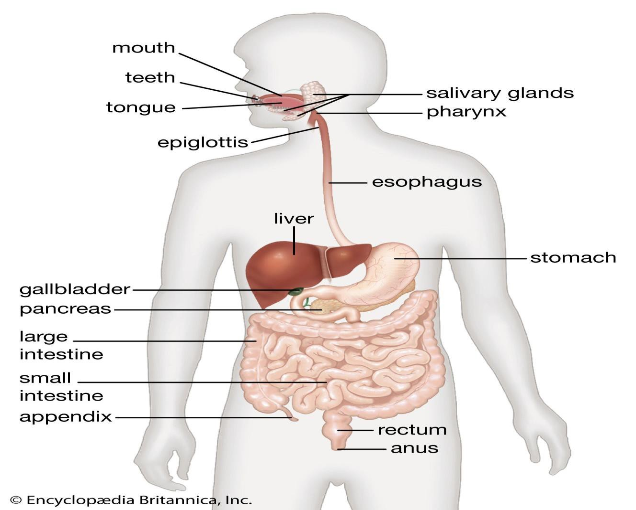
DIAGRAM SHOWING THE GASTRO INTESTINAL SYSTEM

Slide 59
MOUTH
The mouth is an oval-shaped cavity inside the skull. The two main functions of the mouth are eating and speaking. Parts of the mouth include the lips, vestibule, mouth cavity, gums, teeth, hard and soft palate, tongue and salivary glands. The mouth is also known as the oral cavity or the buccal cavity.

Slide 60
esophagus
The esophagus is the muscular tube that carries food and liquids from your mouth to the stomach. You may not be aware of your esophagus until you swallow something too large, too hot, or too cold.

Slide 61
STOMACH
The stomach is a J-shaped organ that digests food. It produces enzymes (substances that create chemical reactions) and acids (digestive juices). This mix of enzymes and digestive juices breaks down food so it can pass to your small intestine emulsification

Slide 62
LIVER
The liver is your largest internal organ., it's located mainly in the upper right portion of your abdomen, beneath the diaphragm and above your stomach.
FUNCTIONS OF A LIVER
Bile production and excretion.
Excretion of bilirubin, cholesterol, hormones, and drugs.
Metabolism of fats, proteins, and carbohydrates.
Enzyme activation.
Storage of glycogen, vitamins, and minerals.
Synthesis of plasma proteins, such as albumin, and clotting factors

Slide 63
small intestine
The small intestine or small bowel is an organ where most of the absorption of nutrients from food takes place. It lies between the stomach and large intestine, and receives bile and pancreatic juice through the pancreatic duct to aid in digestion.

Slide 64
LARGE INTESTINE
The large intestine, also known as the large bowel, is the last part of the gastrointestinal tract and of the digestive system in vertebrates. Water is absorbed here and the remaining waste material is stored in the rectum as feces before being removed by defecation

Slide 65
Conditions affecting gastrointestinal system
Diarrhea
Vomiting
Diabetes mellitus
Intestinal obstruction
Constipation
Peptic ulcerative disease (PUD)
Gastritis

Slide 66
Diarrhea
Diarrhea is a condition defined by an increased frequency of bowel movements (more than three per day)
types of diarrhea
secretory
osmotic
mal absorptive
infectious
exudative

Slide 67
clinical manifestation
Increased frequency and fluid content of stool
Abdominal cramps, distention, intestinal rumbling (borborygmus), anorexia, and thirst
Painful spasmodic contractions of the anus and ineffectual
straining (tenesmus) with each defecation

Slide 68
Management
Inspect mucous membranes and skin to determine hydration status, and assess perianal area.
Increase oral fluids; oral glucose and electrolyte solution maybe prescribed.
IV therapy is used for rapid hydration in very young or elderly patients.
Antimicrobials are prescribed when the infectious agent has
been identified or diarrhea is severe
Recommend bland diet (semisolids to solids) when food intake is tolerated.

Slide 69
Cont..
Encourage patient to limit intake of caffeine and carbonated beverages, and avoid very hot and cold foods because these increase intestinal motility.
Advise patient to restrict intake of milk products, fat, whole grain products, fresh fruits, and vegetables for several days
Monitor serum electrolyte levels closely

Slide 70
CONSTIPATION
Constipation refers to an abnormal infrequency or irregularity of defecation, abnormal hardening of stools that makes their
passage difficult and sometimes painful, decrease in stool volume, or prolonged retention of stool in the rectum

Slide 71
CAUSES
certain medications e.g. zinc sulphate
rectal or anal disorders; obstruction; metabolic, neurologic, and neuromuscular conditions; endocrine disorders;
lead poisoning;
connective tissue disorders; and a variety of disease conditions. weakness, immobility, debility, fatigue,
inability to increase intra-abdominal pressure to pass stools.

Slide 72
CONT…….
develops when people do not take the time or ignore the urge to defecate or as the result of
dietary habits (low consumption
of fiber and inadequate fluid intake),
lack of regular exercise, and a stress-filled life.
Chronic laxative use .

Slide 73
Clinical manifestations
Fewer than three bowel movements per week, abdominal distention, and pain and pressure
Decreased appetite, headache, fatigue, indigestion, sensation of incomplete emptying
Straining at stool; elimination of small volume of hard, dry stool
Complications such as hypertension, hemorrhoids and fissures, fecal impaction, and megacolon

Slide 74
management
Treatment should target the underlying cause of constipation and aim to prevent recurrence, including education,
bowel habit training, increased fiber and fluid intake, and judicious use of laxatives.
Discontinue laxative abuse; increase fluid intake; include
fiber in diet; try biofeedback, exercise routine to strengthen abdominal muscles.
If laxative is necessary, use bulk-forming agents, saline and osmotic agents, lubricants, stimulants, or fecal softeners.
Specific medication therapy to increase intrinsic motor
function (eg, cholinergics, cholinesterase inhibitors, or prokinetic agents).

Slide 75
DIABATES MELLITUS
Diabetes mellitus is a group of metabolic disorders characterized by elevated levels of blood glucose (hyperglycemia) resulting from defects in insulin secretion, insulin action, or both

Slide 76
TYPES OF DIABATES MELLITUS (DM)
Type 1 DM –is characterized by destruction of pancreas due to genetic ,immunologic and possibly environmental e.g. viral .insulin injections is needed to control blood glucose level .has sudden onset before age of 30 years
Type 2 DM - It results from a decreased sensitivity to insulin (insulin
resistance) or from a decreased amount of insulin production.
Type 2 diabetes is first treated with diet and exercise, and then with oral hypoglycemic agents as needed.
Gestational DM – occurs during pregnancy
Drug induced DM – occurs as a result of drugs e.g. steroids e.g. prednisolone

Slide 77
Clinical manifeststations
Polyuria, polydipsia, and polyphagia.
Fatigue and weakness, sudden vision changes, tingling or numbness in hands or feet, dry skin, skin lesions or wounds that are slow to heal, and recurrent infections.
Onset of type 1 diabetes may be associated with sudden weight loss or nausea, vomiting, or stomach pains.

Slide 78
Cont..
Type 2 diabetes results from a slow (over years), progressive glucose intolerance and results in long-term complications if diabetes goes undetected for many years (e.g., eye disease,
peripheral neuropathy, peripheral vascular disease). Complications may have
developed before the actual diagnosis is made.
Signs and symptoms of DKA include abdominal pain, nausea, vomiting, hyperventilation, and a fruity breath odor.
Untreated DKA may result in altered level of consciousness,
coma

Slide 79
Management
Physical exercise
Lifestyle modification
Meal plan and taking diabetic meals
Taking drugs as prescribed
Regularly monitoring blood sugar as adviced

Slide 80
GASTRITIS
Gastritis is inflammation of the stomach mucosa. Acute gastritis lasts several hours to a few days and is often
caused by
dietary indiscretion (eating irritating food that is highly seasoned or food that is infected).
excessive use of aspirin and other nonsteroidal anti-inflammatory drugs (NSAIDs),

Slide 81
CONT…..
excessive alcohol intake, bile reflux, and radiation therapy.
A more severe form of acute gastritis is
caused by strong acids or alkali, which may cause the mucosa to become gangrenous or to perforate.
Gastritis may also be
the first sign of acute systemic infection (HELICOBACTOR PYLORI )

Slide 82
CLINICAL PRESENTATION
Acute Gastritis
May have rapid onset of symptoms: abdominal discomfort, headache, lassitude, nausea, anorexia, vomiting, and hiccupping Chronic Gastritis
May be asymptomatic.
Complaints of anorexia, heartburn after eating, belching, a sour taste in the mouth, or nausea and vomiting.
Patients with chronic gastritis from vitamin deficiency usually have evidence of
malabsorption of vitamin B12.

Slide 83
MANAGEMENT
Avoiding acidic foods e.g. caffeine, nicotine, spicy foods, irritating or highly seasoned foods,
Analgesics e.g. paracetamol
Anti acids
Avoiding acidic drugs e.g. Diclofenac
Stress management Discourage caffeinated beverages (caffeine increases gastric
activity and pepsin secretion), alcohol, and cigarette smoking (nicotine inhibits neutralization of gastric acid in the
duodenum).

Slide 84
PEPTIC ULCERS
A peptic ulcer is an excavation formed in the mucosal wall of the stomach, pylorus, duodenum, or esophagus. It is frequently
referred to as a gastric, duodenal, or esophageal ulcer, depending on its location
Peptic ulcers are more likely to be
in the duodenum than in the stomach.

Slide 85
Causes
Helicobacter pylori (h pylori)
Chronic use of NSAIDS drugs e.g. diclofenac
Alcoholism
Excessive smoking
High degree stress

Slide 86
Clinical manifestations
Symptoms of an ulcer may last days, weeks, or months and may subside only to reappear without cause. Many patients have asymptomatic ulcers.
Dull, gnawing pain and a burning sensation in the midepigastrium or in the back are
characteristic.
Pain is relieved by eating or taking alkali; once the stomach has emptied or the alkali wears
off, the pain returns.
Sharply localized tenderness is elicited by gentle pressure on the epigastrium or slightly right of the midline.
Other symptoms include pyrosis (heartburn) and a burning sensation in the esophagus and stomach, which moves up to the mouth, occasionally with sour eructation (burping).
Vomiting is rare

Slide 87
Management
Stress reduction and rest are priority interventions. The patient needs to identify situations that are stressful or
exhausting . implement changes, such as establishing regular rest periods during the day .
Smoking cessation is strongly encouraged because smoking raises duodenal acidity and significantly inhibits ulcer repair.
•

Slide 88
CONT..
Dietary modification may be helpful. Patients should eat
whatever agrees with them . Alcohol and caffeinated beverages such as coffee (including d Diets rich in milk and cream should be avoided also because they are potent acid stimulators. caffeinated coffee, which stimulates acid secretion) should be avoided .
Monitor vital signs closely
Drugs e.g. antacids

Slide 89
HEPATITIS B
Hepatitis B virus (HBV) is a DNA virus transmitted primarily through blood. The virus has been found in saliva, semen,
and vaginal secretions and can be transmitted through mucous membranes and breaks in the skin. Hepatitis B has a long incubation period (1 to 6 months). It replicates in the liver
and remains in the serum for long periods, allowing transmission of the virus.

Slide 90
RISK FACTORS
Those at risk include
all health care workers,
patients in hemodialysis and oncology units,
Sexually active homosexual and bisexual men,
and IV drug users.
About 10% of patients progress to a carrier state or develop chronic hepatitis. Hepatitis B remains a major worldwide cause of cirrhosis and hepatocellular carcinoma.

Slide 91
CLINICAL MANIFESTATION
Symptoms may be insidious and variable; subclinical episodes frequently occur, fever and respiratory symptoms are rare; some patients have arthralgias and rashes.
Loss of appetite, dyspepsia, abdominal pain, general aching,
malaise, and weakness may occur.
Jaundice may or may not be evident. With jaundice, there are light-colored stools and dark urine.
Liver may be tender and enlarged; spleen is enlarged and palpable in a few patients. Posterior cervical lymph nodes may also be enlarged.

Slide 92
PREVENTION
Screening of blood donors
Good personal hygiene
Education
Hepatitis B vaccine

Slide 93
MANAGEMENT
Convalescence may be prolonged and recovery may take 3 to 4 months; encourage gradual activity after complete clearing of jaundice.
Identifies psychosocial issues and concerns, particularly the effects of separation from family and friends if the patient is hospitalized; if not hospitalized, the patient will be unable
to work and must avoid sexual contact.
Include family in planning to help reduce their fears and anxieties about the spread of the disease.
Instruct patient and family to provide adequate rest and nutrition.
Inform family and intimate friends about risks of contracting hepatitis B.

Slide 94
CONT…
• Arrange for family and intimate friends to receive hepatitis B vaccine or hepatitis B immune globulin as prescribed.
Caution patient to avoid drinking alcohol and eating raw shellfish.
Inform family that follow-up home visits by home care nurse are indicated to assess progress and understanding, reinforce teaching, and answer questions.

Slide 95
CONT…
• Encourage patient to use strategies to prevent exchange of body fluids, such as avoiding sexual intercourse or using condoms.
Emphasize importance of keeping follow-up appointments and participating in other health promotion activities and recommended health screenings.

Slide 96
GENITAL URINALY SYSTEM
RENAL FAILURE
Renal failure results when the kidneys are unable to remove metabolic waste and perform their regulatory functions. Acute
renal failure (ARF) is a rapid loss of renal function due to damage to the kidneys.

Slide 97
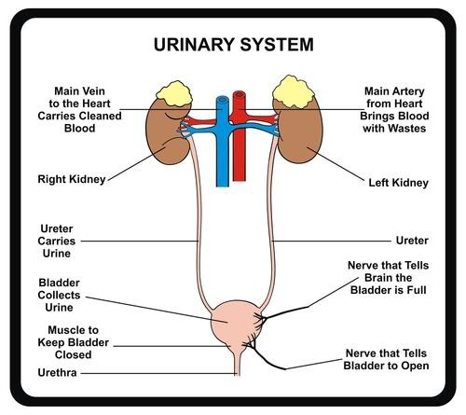
DIAGRAM SHOWING URINALY SYSTEM

Slide 98
KIDNEYS
The kidneys' function is to filter your blood. They remove wastes, control the body's fluid balance, and keep the right levels of electrolytes. All of the blood in your body passes through them. Blood comes into the kidney, waste gets removed, and salt, water, and minerals are adjusted, if needed.

Slide 99
Ureter
The ureter is a tube that carries urine from the kidney to the urinary bladder. There are two ureters, one attached to each kidney. The upper half of the ureter is located in the abdomen and the lower half is located in the pelvic area.

Slide 100
Bladder
Bladder. This triangle-shaped, hollow organ is located in the lower abdomen. It is held in place by ligaments that are attached to other organs and the pelvic bones. The bladder's walls relax and expand to store urine, and contract and flatten to empty urine through the urethra.

Slide 101
Urethra
Urethra. This tube allows urine to pass outside the body. The brain signals the bladder muscles to tighten, which squeezes urine out of the bladder. At the same time, the brain signals the sphincter muscles to relax to let urine exit the bladder through the urethra.

Slide 102
CATEGORIES OF ACUTE RENAL FAILURE
Three major categories of ARF are prerenal
(hypo perfusion, as from volume depletion disorders, extreme vasodilation, or impaired cardiac performance); intrarenal (parenchymal damage to the glomeruli or kidney tubules, as from burns, crush injuries, infections, transfusion reaction, or nephrotoxicity, which may lead to acute tubular necrosis
[ATN]); and postrenal (urinary tract obstruction, as from calculi, tumor, strictures, prostatic hyperplasia, or blood clots)

Slide 103
Clinical manifestation
Critical illness and lethargy with persistent nausea, vomiting, and diarrhea.
Skin and mucous membranes are dry.
Central nervous system manifestations: drowsiness, headache, muscle twitching, seizures.
Urine output scanty to normal; urine may be bloody with low specific gravity.
Anemia from blood loss due to uremic GI lesions, reduced
red blood cell life-span, and reduced erythropoietin production.
Hyperkalemia may lead to dysrhythmias and cardiac arrest.

Slide 104
Management
Monitoring fluid and electrolyte balance
Screen parenteral fluids, all oral intake, and all medications for hidden sources of potassium.
Monitor cardiac function and musculoskeletal status for signs of hyperkalemia.
Pay careful attention to fluid intake , urine output, apparent edema, distention of the jugular veins, alterations in heart sounds and breath sounds, and increasing difficulty in breathing.
Maintain daily weight and intake and output records.
.

Slide 105
Cont..
Adequate intake of calories and vitamins is ensured. Calories are supplied with carbohydrates and fats to prevent
wasting.
Protein is restricted; allowed protein must be of high biologic value (dairy products, eggs,
meats).
Vitamin supplementation.
Report indicators of deteriorating fluid and electrolyte status immediately. Prepare for emergency treatment of hyperkalemia. Prepare patient for dialysis as indicated to correct fluid and electrolyte imbalances

Slide 106
BENIGN PROSTETIC HYPERPLASIA (BPH)
Benign prostatic hyperplasia (BPH) is enlargement, or hypertrophy, of the prostate gland. The prostate gland enlarges,
extending upward into the bladder and obstructing the outflow of urine. BPH is common in men older than 40 years

Slide 107
CLINICAL MANIFESTATIONS
• Hesitancy in starting urination, increased frequency of urination, nocturia, urgency, abdominal straining.
Decrease in volume and force of urinary stream, interruption of urinary stream,
dribbling.
Sensation of incomplete emptying of the bladder, acute urinary retention (more than 60 mL), and recurrent UTIs.
Fatigue, anorexia, nausea and vomiting, and pelvic discomfort are also reported,
and ultimately azotemia and renal failure result with chronic urinary retention and large residual

Slide 108
MANAGENT
Urinary catheterization
Treatment of the Urinary tract infections
Prostatectomy

Slide 109
Task
Urinary tract infection
Candidiasis
Prostitis
Cancer
Acne valguris

Slide 110



MUSCULAR SKELETAL
AND SKIN

Slide 111
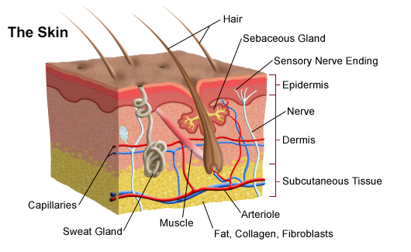
DIAGRAM SHOWING THE SKIN

Slide 112
Functions of the skin
Provides a protective barrier against mechanical, thermal and physical injury and hazardous substances.
Prevents loss of moisture.
Reduces harmful effects of UV radiation.
Acts as a sensory organ (touch, detects temperature).
Helps regulate temperature.
An immune organ to detect infections.

Slide 113
OSTEOARTHRITIS
OA, also known as degenerative joint disease or osteoarthrosis, is the most common and most frequently disabling joint
disorder. It is characterized by a progressive loss of joint cartilage

Slide 114
RISK FACTORS
age, OA peaks between the fifth and sixth decades of life
congenital and
developmental disorders of the hip
obesity
previous joint damage
repetitive use (occupational or recreational), anatomic
deformity

Slide 115
CLINICAL MANIFESTATION
Pain, stiffness, and functional impairment are primary clinical manifestations.
Stiffness is most common in the morning after awakening. It usually lasts less than 30 minutes and decreases with movement.
Functional impairment is due to pain on movement and limited joint motion when structural changes develop.
OA occurs most often in weight-bearing joints (hips, knees, cervical and lumbar spine); finger joints are also involved.

Slide 116
MEDICAL MANAGEMENT
Management focuses on slowing and treating symptoms
because there is no treatment available that stops the degenerative joint disease process.

Slide 117
PREVENTION
Weight reduction
Prevention of injuries
Perinatal screening for congenital hip disease
•Exercise

Slide 118
FRACTURES
A fracture is a complete or incomplete disruption in the continuity of bone structure and is defined according to its type
and extent. Fractures occur when the bone is subjected to stress greater than it can absorb

Slide 119
CAUSES
Fractures can be caused by a
direct blow, crushing force, sudden twisting motion, or even extreme muscle contractions.

Slide 120
TYPES OF FRACTURES
Complete fracture: a break across the entire cross section of the bone, which is frequently displaced.
Incomplete fracture, also called greenstick fracture: Break occurs only through part of the cross section of the bone.
Comminuted fractures: a break with several bone fragments.
Closed fracture, or simple fracture: does not produce a break in the skin.

Slide 121
CONT…
Open fracture, or compound or complex fracture: a break in which the skin or mucous membrane wound extends to the fractured bone. Open fractures are graded as follows: grade I: a clean wound less than 1 cm long; grade II: a larger wound without extensive soft tissue damage; grade III: wound is highly contaminated and has extensive soft tissue damage (most severe type).
An intra-articular fracture extends into the joint surface of a bone.

Slide 122
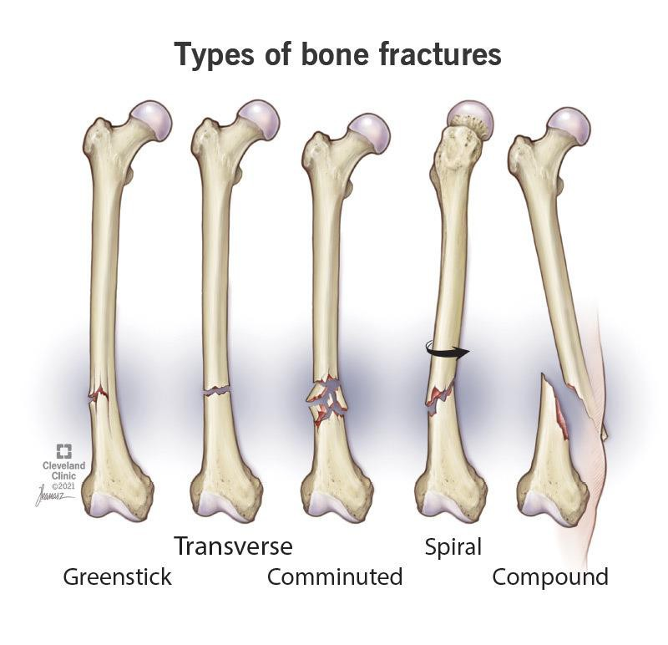
Diagram showing different types of fractures

Slide 123
The clinical signs and symptoms of a fracture
Acute pain
loss of function
Deformity
shortening of the extremity crepitus, localized edema

Slide 124
EMERGENCY MANAGEMENT
Immediately after injury, immobilize the body part before the patient is moved.
Splint the fracture, including joints adjacent to the fracture, to prevent movement of fracture fragments.
Immobilization of the long bones of the lower extremities may be accomplished by bandaging the legs together, with the unaffected extremity serving as a splint for the injured one.

Slide 125
CONT……..
In an upper extremity injury, the arm may be bandaged to the chest, or an injured forearm may be placed in a sling.
Assess neurovascular status distal to the injury both before
and after splinting to determine adequacy of peripheral tissue perfusion and
nerve function.
Cover the wound of an open fracture with a sterile dressing to prevent contamination of deeper tissues.

Slide 126
MANAGING CLOSED FRACTURES
Instruct the patient regarding the proper methods to control edema and pain (eg, elevate extremity to heart level,
take analgesics as prescribed).
Teach exercises to maintain the health of unaffected muscles and to
strengthen muscles needed for transferring and for using assistive devices (eg, crutches, walker).

Slide 127
CONT…………
Teach patients how to use assistive devices safely.
Arrange to help patients modify their home environment as needed and to secure personal assistance if necessary.
Provide patient teaching, including self-care, medication information, monitoring for potential complications, and the need for continuing health care supervision.

Slide 128
MANAGING OPEN FRACTURE
The objectives of management are to prevent infection of the wound, soft tissue, and bone and to promote healing of bone and soft tissue. In an open fracture, there is the risk of osteomyelitis, tetanus, and gas gangrene.
Administer IV antibiotics immediately upon the patient’s arrival in the hospital along with tetanus toxoid if
needed.

Slide 129
CONT…….
Perform wound irrigation and debridement.
Elevate the extremity to minimize edema.
Assess neurovascular status frequently.
Take the patient’s temperature at regular intervals, and monitor for signs of
infection.

Slide 130
GROUP WORK
DISCUSS AND WRITE NOTES ON
Discuss and write notes on :
Dermatitis
include
Definition
Causes
Clinical presentation /signs and symptoms
Preventive measures
Management and home remedies

